Slide 1
Application of Various Schemes for Numerical Solution of Transport Equation
Grigory A. Senchenok, email: grishasenchenok@yandex.ru
Igor S. Men’shov, email: imen57@mail.ru
Lomonosov Moscow State University
Department of Mechanics and Mathematics,
Keldysh Institute of Applied Mathematics of Russian Academy of Science
Keywords: Transport equation, numerical solution, digital geometry, THINC scheme, Godunov's scheme, MUSCL scheme,
2020-2021

Slide 2
Abstract
The transport equation is a partial differential equation that describes the evolution of a scalar function in space and time. The solution of this equation allows to describe the transport of a scalar field (e.g. chemical concentration, material properties or temperature) inside an incompressible flow. The transport equation is also called the convection-diffusion equation. This first-order partial differential equation is the basis for the most common transportation models. Representation of solid body as the scalar field allows to apply this approach to describe a rigid body movement either. Such representing is the translation of body’s geometry into the digital geometry. In this article the representation of geometry of rigid body in digital way is presented. Also the various schemes are considered for numerical solution of transport equation in 1D case. Common schemes, such an Godunov’s 1st order scheme or MUSCL 2nd order scheme, were implemented in C++ program language. More complex approach is the application THINC scheme is also considered in this paper. This scheme allows to keep the initial picture of scalar field more priecise during the computation steps and decrease the error magnitude of final result. All computation results are visualized and the table of error magnitudes presented.

Slide 3
Introduction
In this work the problem of digital representation of the motion of a rigid body is considered. Digital Geometry (DG) is that body geometry is set by a characteristic function; its evolution is described by the transport equation; motion simulation is carried out by numerically solving the transport equation on the grid. The purpose of this work is the numerical implementation of the THINK scheme for calculating DG in the one-dimensional case, as well as the comparison of various schemes.
In industrial calculation systems (for example, CAD), the finite element method is used to describe the geometry: a mesh consisting of simple elements is introduced over the entire study area: for a two-dimensional case, these are polygons, for a three-dimensional case, polyhedra. Thus, an accurate calculation takes place for a large number of small finite elements, which requires large computing power to describe each primitive and a complex partition into these finite elements.

Slide 4
Introduction
In the method described in this work, the geometry of the body is specified by a characteristic function: the so-called digital geometry. Its evolution is described by the transport equation. This greatly simplifies the implementation of the grid and simplifies the calculations, while maintaining the accuracy at a sufficiently high level.
Formulation of the problem: From the known distribution of the function of the scalar quantity f at the initial time instant and velocity field at each time instant, it is necessary to calculate the characteristic function of a rigid body and liquid (scalar quantity f) in the considering area at each time step.

Slide 5
Methods and materials
Characteristic function, formulation of the problem, THINC & oths. schemes

Slide 6
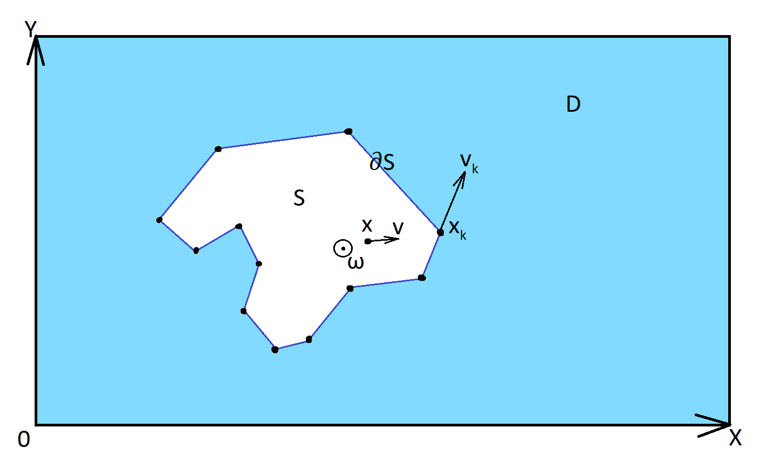
The velocity field of a rigid body
Fig.1: The velocity field of a rigid body
Within the framework of the solution of the previous problem, the velocity field in the area D, induced by a rigid body during motion, was calculated.

Slide 7


Characteristic function of a solid body
The characteristic function of a solid is a function - indicator:
The transport equation is a partial differential equation that describes the evolution of a scalar quantity in space and time:

Slide 8
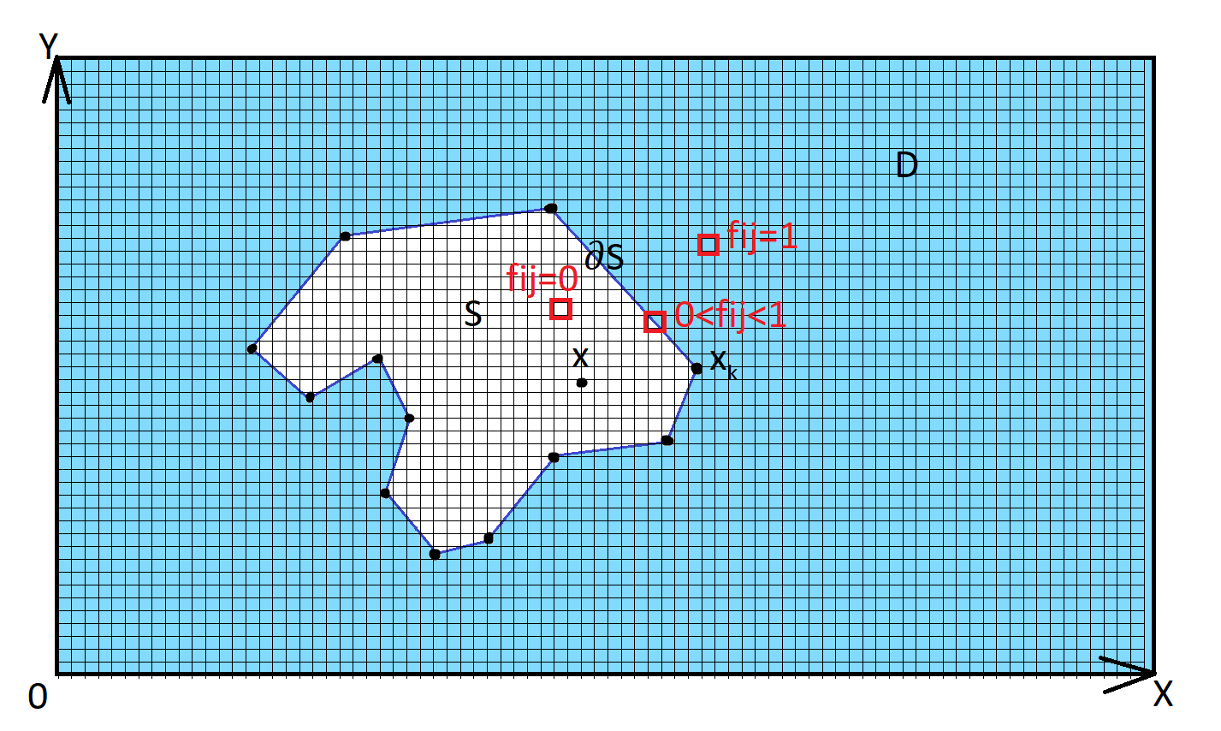
Characteristic function of a solid body
Fig.2: Characteristic function of a solid body

Slide 9
Characteristic function of a solid body
Initial conditions for the transport equation:
Velocity field u
Initial position of the solid boundary points
The results to be obtained: The characteristic function f in the region D on the time interval [0; T]

Slide 10
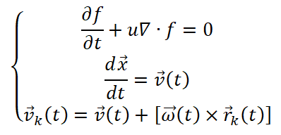
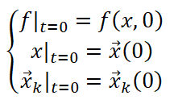
Mathematical formulation of the problem
Thus, the problem can be represented as a system of differential equations:
With initial conditions:

Slide 11
1D Consideration: Sampling
Segment [0; X], on which the given equation is considered, is divided into cellCount of consecutive subsegments, each of length ΔXi. ΔXi = X (i + 1/2) -X (i-1/2). Positions X (i + 1/2), X (i-1/2) are the nodes of this grid.Δt - time step length

Slide 12

THINC scheme
To numerically solve the transport equation, the THINC - tangent of hyperbola for interface capturing was considered where u is the vector field of velocities
f is the transported scalar quantity

Slide 13

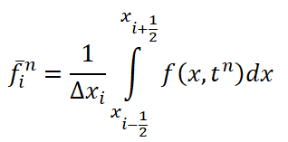


In the one-dimensional case, for a solenoidal velocity field:
the average value of the function f on the i-th interval ΔXi at the n-th time step:
Approximation f (i) n:

Slide 14
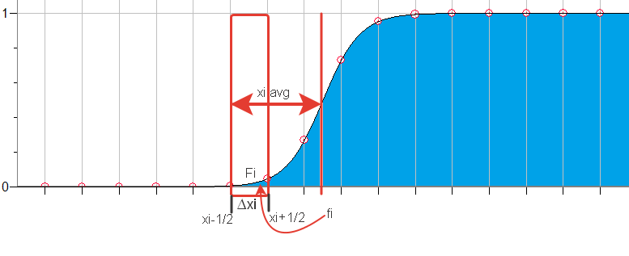
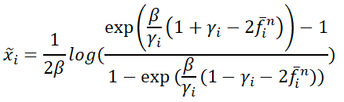
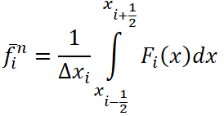
The parameter is the relative distance to the middle of the jump f from the left border of the segment X (i-1/2).
Fig.3: xi average

Slide 15

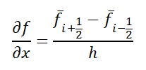
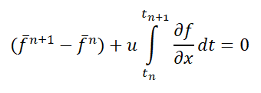
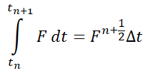

Numerical solution of the transport equation in the one-dimensional case

Slide 16

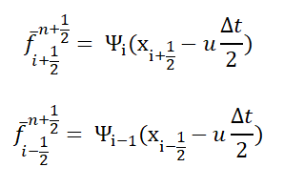

Slide 17
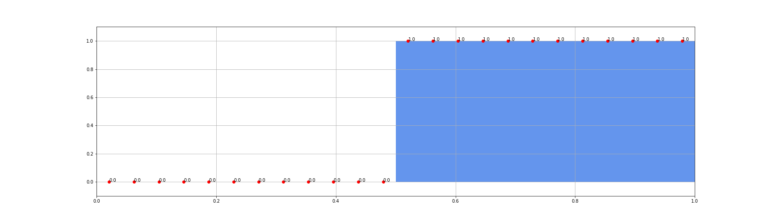
Application of various schemes to approximate the jump
Godunov's scheme
MUSCL scheme
THINK + Godunov schemes
THINK + MUSCL schemes
Fig.4: initial contitions

Slide 18

Investigation of the error and rate of convergence of methods
If the inequality
Is true
Then the method has the order of convergence

Slide 19
Results
Schemes implementation and error convergence investigation

Slide 20

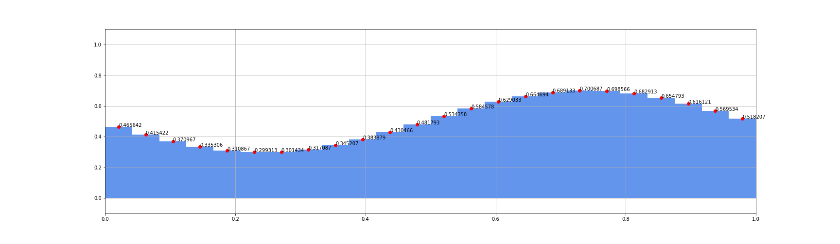
Godunov's scheme
t=0
t=2T
Fig.5: Godunov scheme results

Slide 21
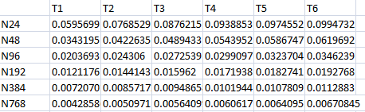
Error table for Godunov's scheme
Table1: Error magnitude for Godunov's scheme

Slide 22
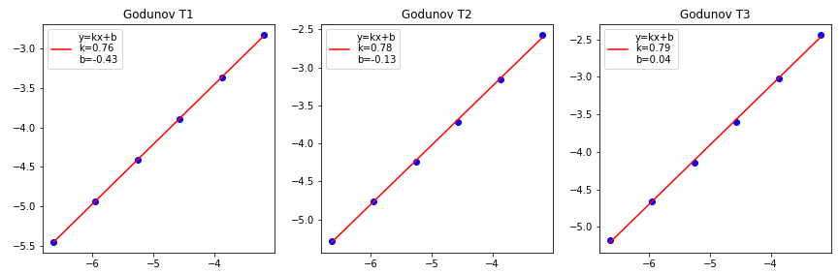
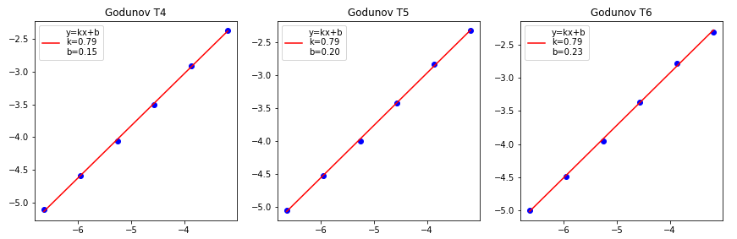
Convergence of Godunov's method
Fig.6: Convergence of Godunov's method

Slide 23
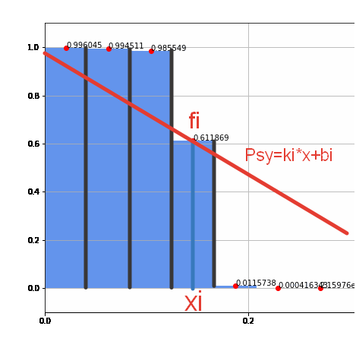
MUSCL scheme
Fig.6: MUSCL scheme

Slide 24
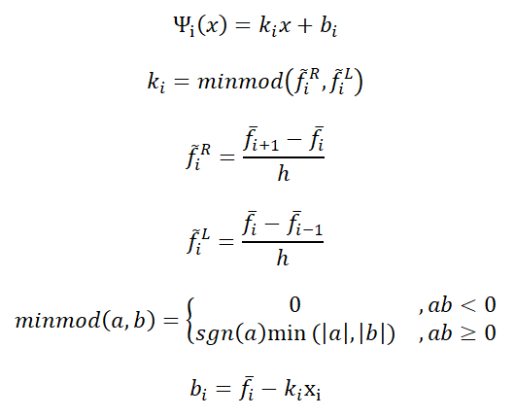
MUSCL scheme

Slide 25
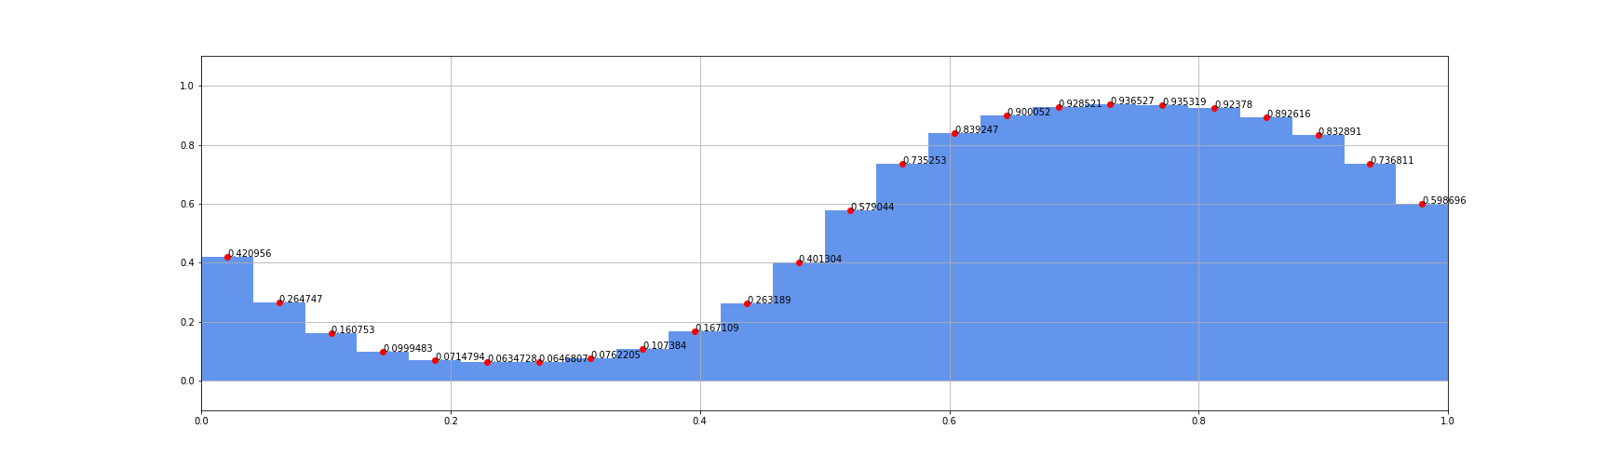
MUSCL scheme
t=0
t=2T
Fig.7: MUSCL scheme results

Slide 26
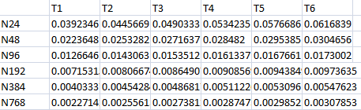
Error table for MUSCL schema
Table2: Error table for MUSCL schema

Slide 27
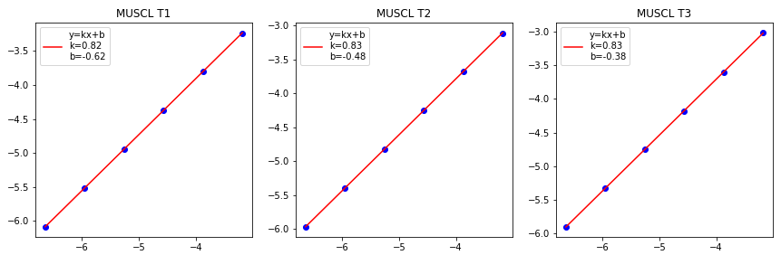
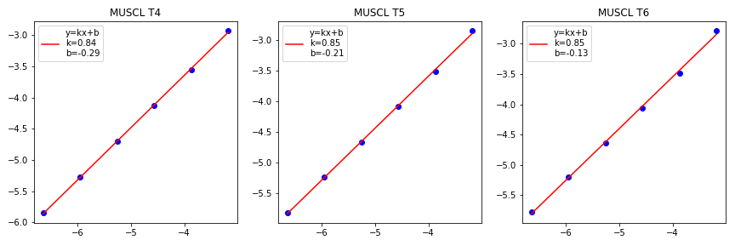
Convergence of the MUSCL method
Fig.8: Convergence of the MUSCL method

Slide 28

THINK + Godunov / MUSCL scheme
Condition is met
The condition is not met
THINC
Godunov/MUSCL

Slide 29
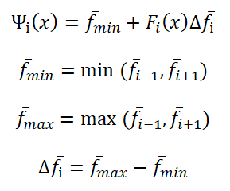
THINC

Slide 30





THINC

Slide 31


THINC

Slide 32
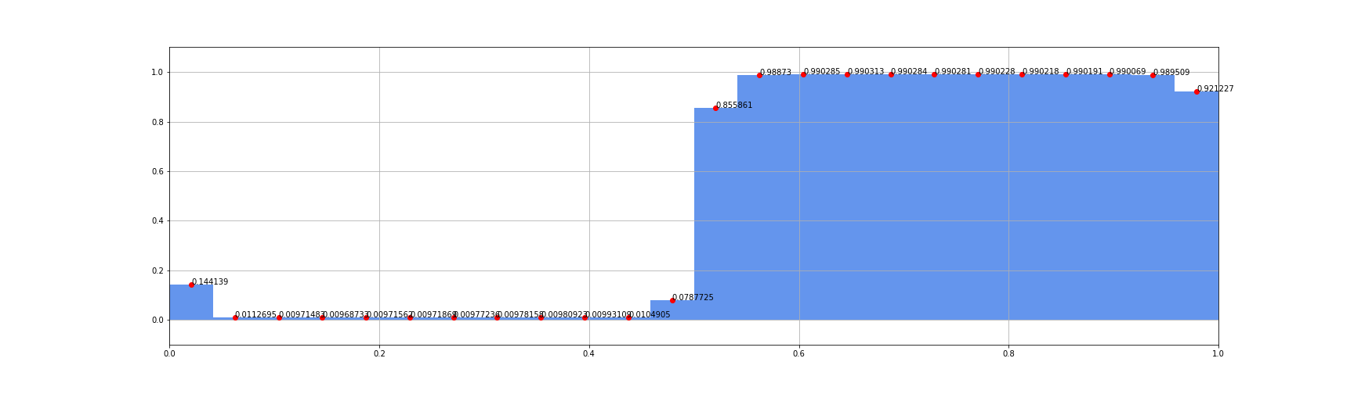
THINC + Godunov
t=0
t=5T
Fig.9: THINC + Godunov scheme results

Slide 33
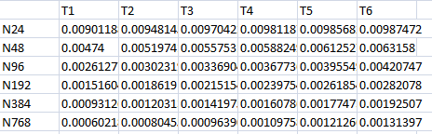
Error table for the THINC + Godunov scheme
Table3: Error table for THINC + Godunov schema

Slide 34
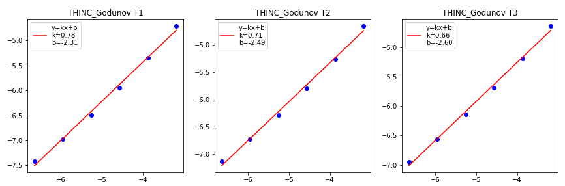
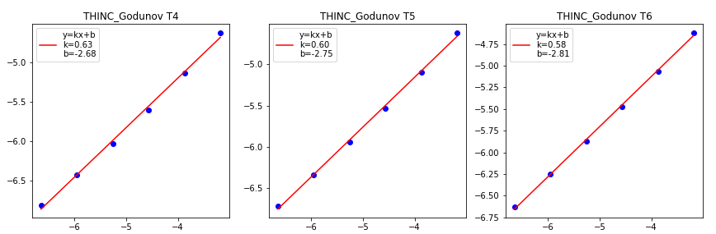
Convergence of the THINC + Godunov method
Fig.10: Convergence of the THINC + Godunov method

Slide 35

THINC + MUSCL
t=0
t=5T
Fig.11: THINC + MUSCL schemes results

Slide 36
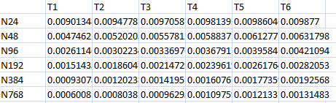
Error table for THINC + MUSCL scheme
Table4: Error table for THINC + MUSCL schema

Slide 37
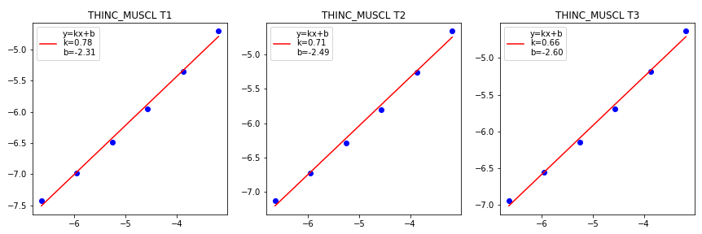
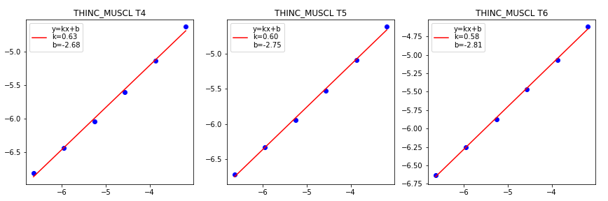
Convergence of the THINC + MUSCL method
Fig.12: Convergence of the THINC + Godunov method

Slide 38
Conclusion
Thus, methods for the numerical solution of the transport equation using the digital geometry approach were investigated.
A numerical method for solving the transport equation was investigated and its software algorithm was implemented for the one-dimensional case.
It is important to note that the study of schemes for solving the transport equation in the one-dimensional case makes it possible to use this approach in two-dimensional and three-dimensional space.
To represent digital geometry, schemes with different orders of accuracy were investigated, including Godunov's scheme, MUSCL and THINC.
The use of the THINC scheme, in contrast to other schemes, allows to describe the behavior of geometry in digital form with high accuracy.
The program written for the one-dimensional case will be used in the future as a computational block for the multidimensional case.

Slide 39
Acknowledgements
The author would like to thank his scientific adviser Igor S. Men’shov, who provided the essential theory for research and discussed the process of program implementation of schemes.
The author acknowledges the support from Keldysh Institute of Applied Mathematics on the basis of which the work was carried out

Slide 40
References
A simple algebraic interface capturing scheme using hyperbolic tangent function. F. Xiao, Y. Honma and T. Kono (2005)
Application of the quadrature method for the numerical solution of integral equations of the second kind. I.O. Arushanyan (2018)
Revisit to the THINC scheme: A simple algebraic VOF algorithm. Feng Xiao, Satoshi Ii, Chungang Chen (2011)
An Eulerian interface sharpening algorithm for compressible two-phase flow: The algebraic THINC approach. Keh-Ming Shyue, Feng Xiao (2014)
Theoretical Mechanics. S. V. Bolotin, A. V. Karapetian, E. I. Kugushev, D. V. Treshchev (2010)

